Slide 1







Enterprise Blockchain Developers (Intermediate)
In support of
Powered By

Slide 2
Outline
Router Design
Links and History
Context
Change class to functional component
Summarize technique implementation process:
Hyperledger Dapp+ChainCode, React Logic, JWT
IPFS Storage
Dive into Proxy
© 2017-2020 SmartMesh Foundation Pte. Ltd. | MeshBox Foundation Pte. Ltd.

Slide 3
React Router Design
Logic:
if not loggedin => goes to login page
other wise => dashboard
swith subpages (define switch for the first level router) example App
secondary subpages (define switch for the second level router)
example contract
note: render according to the level

Slide 4
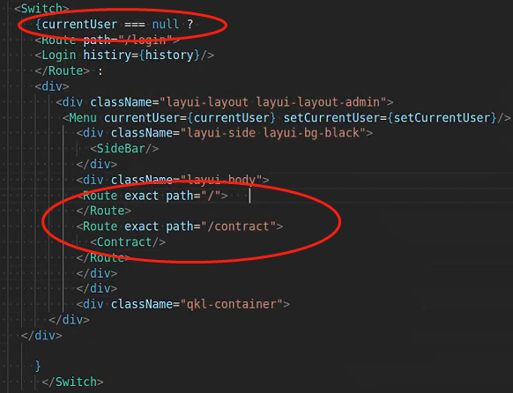
React Router Design

Slide 5
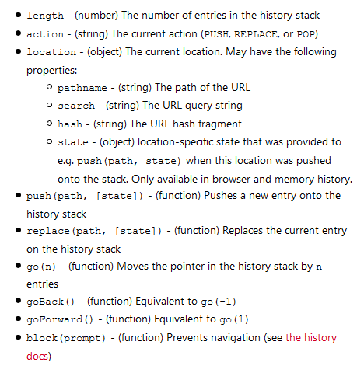
React Links and History
What is link?
Link is the substitution for <a> tag when we implement Router in Reactjs
Used in HTML
What is history?
Used in function to do
redirect
go back etc

Slide 6
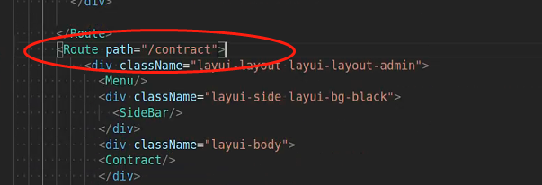
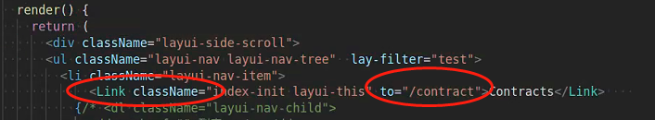
React Links and History
How to implement Link
Step 1: Define a Route in App.js
Add Link in SideBar.js

Slide 7

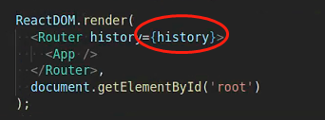
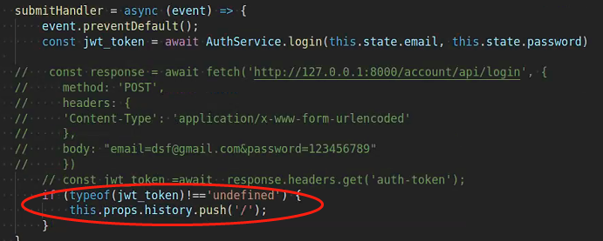
React Links and History
How to implement History
Step 1: Create History
Add intert history as a prop
Call history

Slide 8
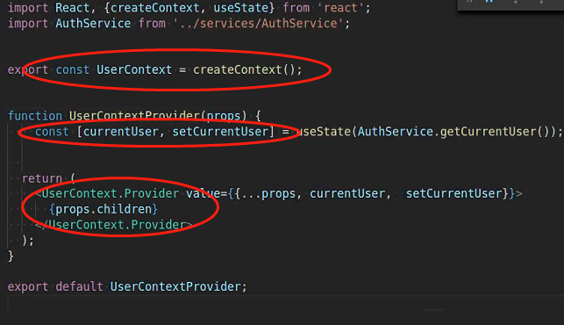
Context
Add currentUserContext
Step 1: Create provider:
create context, create state variables, create provider

Slide 9
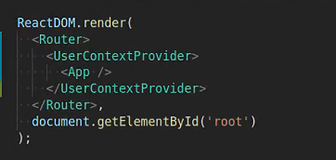
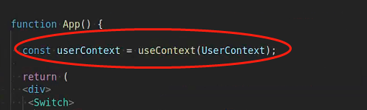
Context
Add currentUserContext
Step 2: Add Wrapper
Step 3 Implement Context

Slide 10
Change Class to Functional Component
Add currentUserContext
Step 2: Add Wrapper
Step 3 Implement Context

Slide 11
Summarize technique implementation process
1 Hyperledger
Step 1: Start Network
Step 2: Write the chaincode
Step 3 Implement Context

Slide 12
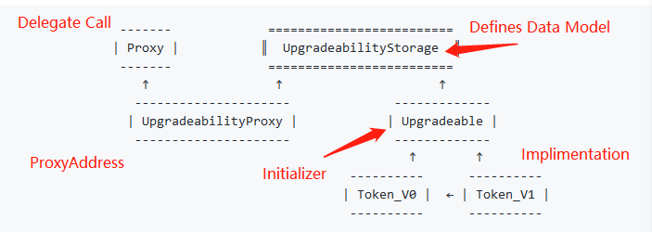
Dive into Proxy (Architect a Solidity Program)
Inherited, Unstructured, External Storage, ProxyFactory and ProxyAdmin
(Code Explain)
Inherited
What does it mean by upgradability? there is a initializer in the smartcontract or there are no constructor / initializer

Slide 13
Dive into Proxy (Architect a Solidity Program)
Drawbacks:
Data Model cannot be changed, can only be updated or add new features
(Code Explain)

Slide 14
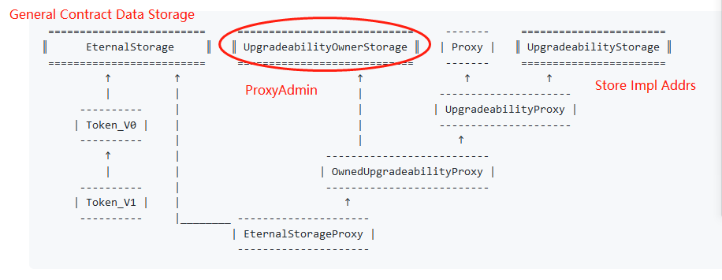
Dive into Proxy (Architect a Solidity Program)
Eternal Storage
(Code Explain)

Slide 15
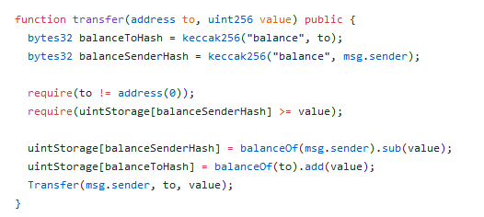
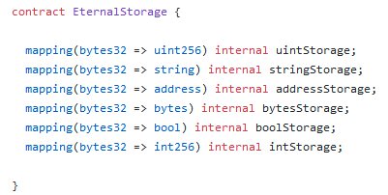
Dive into Proxy (Architect a Solidity Program)
Eternal Storage

Slide 16
Dive into Proxy (Architect a Solidity Program)
Pros:
The actural impl contract's data structure doesn't need to follow the previous impl contract's data structure
Cons:
Hard to write, as we need to extract all the data storing out

Slide 17
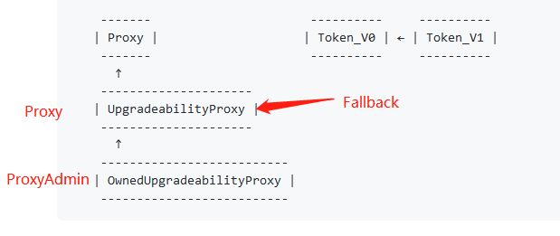
Dive into Proxy (Architect a Solidity Program)
Unstructured
(Code Explain)

Slide 18
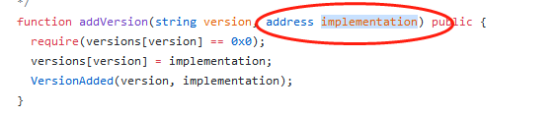

Dive into Proxy (Architect a Solidity Program)
Unstructured
Use pregenerated impl address
Use fixed impl Use pregenerated address
address

Slide 19
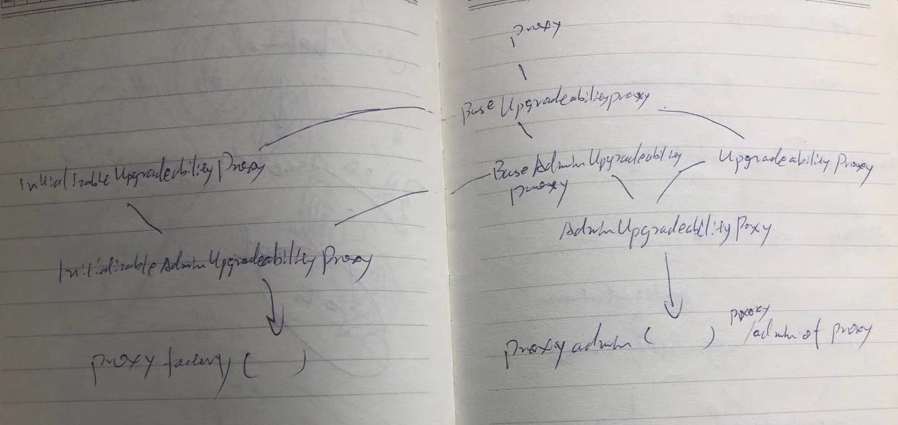
Dive into Proxy (Architect a Solidity Program)
ProxyAdmin & ProxyFactory (Code Explain)
Check if IniupgradProxy and AdminUpgradeProx have initializer (Inherited with admin)
Unstructured Storage has contrustor, so can use upgradeto without init data

Slide 20
Code Demo
Upgrade StoreFactory from depolymini to depoly and add Proxy admin

Slide 21
Web3js
1 change class to functional component
2 add context

Slide 22
Web3js
1 change class to functional component
2 add context

